Slide 1
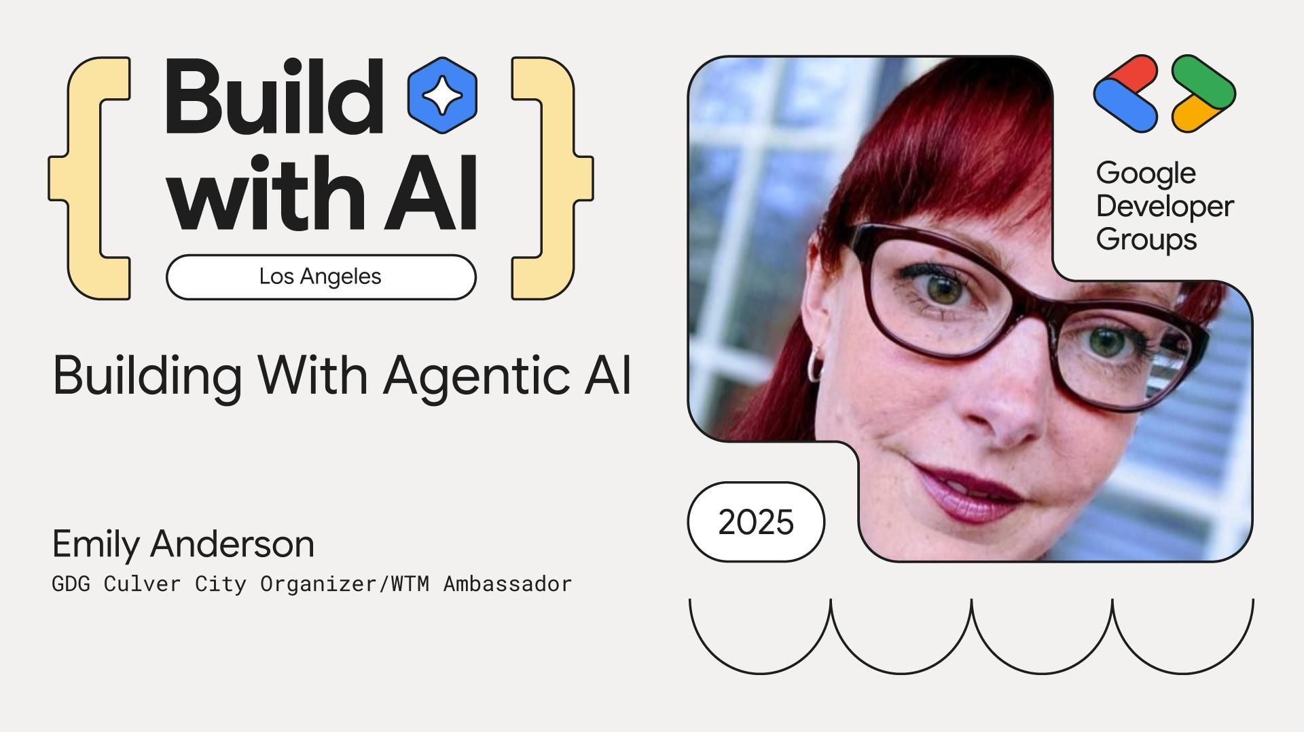

Slide 2

Agenda
A few key points
What it is
Why it’s important
Examples
Demos

Slide 3

A few key points (WIP)
Empowerment over replacement – AI is here to supercharge our skills, not take our jobs.
Mindset matters – Continuous learning is critical to leveraging AI effectively.
Powerful but not magic – Amazing capabilities, but there’s a learning curve.
Context is everything – AI output quality depends on what you feed it.

Slide 4

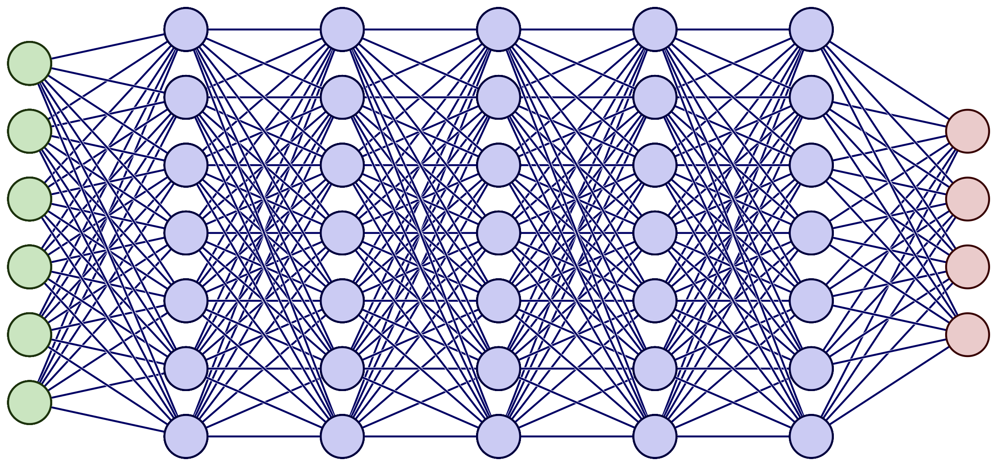

What it is
User
Agent/Orchestration Layer
+ IDE/Codebase
Generative AI Model
Request
Question
Task
Etc.
Task creation and orchestration
Context management
Architect
Code
Test
Debug
Document
Etc.

Slide 5
Why it’s important
Capabilities and quality of output increasing rapidly (models and tooling)
Major tech companies already generating substantial % of code with AI (add “as of NOW” stats)
Dramatically increases productivity (with caveats)
Reduces reliance on vendors
Potential for more build vs. buy
Build, market, sell our own products / IP
Something about not falling behind (we need to be able to attract the right talent)

Slide 6
EXAMPLES
Build a web application called "PRODUCTIZER" with the following specifications: **Core Functionality:** - Create an AI-powered product analysis tool that takes product context as input and generates comprehensive product summaries - The output should include: features, key technologies, high-level architectures, multi-tenancy factors, and other relevant product details - Use Anthropic Claude Sonnet 4 as the LLM for processing and analysis **Technical Stack:** - Backend: Node.js with Express framework - Frontend: Vanilla JavaScript with TypeScript - No HTTPS required (demo/development environment) - Simple text input interface initially (single textarea for product context input) **UI/UX Design:** - Theme: Monster or dinosaur "chomping through" product context - Visual metaphor: The app should feel like a creature consuming and digesting product information to produce insights - Consider monster/dinosaur imagery, animations, or visual elements that reinforce this theme **Development Approach:** - Start with basic functionality: text input → AI processing → formatted output display - Structure the codebase to easily accommodate future enhancements - Plan for future features like document upload (Word docs, PDFs, etc.) but don't implement yet **Project Setup:** - Initialize as a new Node.js project with proper TypeScript configuration - Set up Express server with appropriate routes for the AI processing - Create a clean, responsive frontend interface - Implement proper error handling and loading states **Deliverables:** 1. Working web application with text input and AI-generated product summaries 2. Monster/dinosaur themed UI that's both functional and engaging 3. Clean, maintainable code structure ready for future enhancements

Slide 7
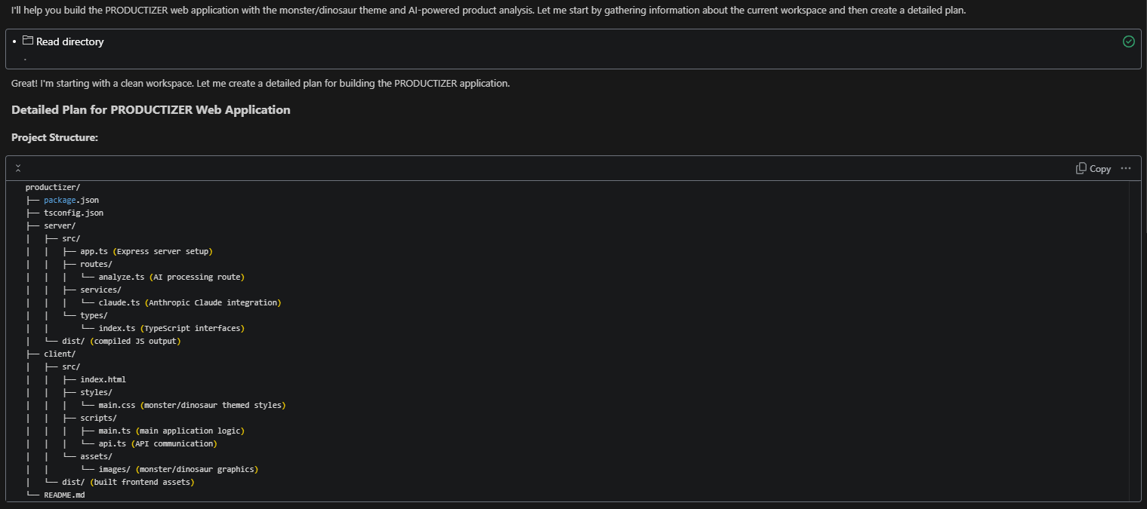
EXAMPLES

Slide 8
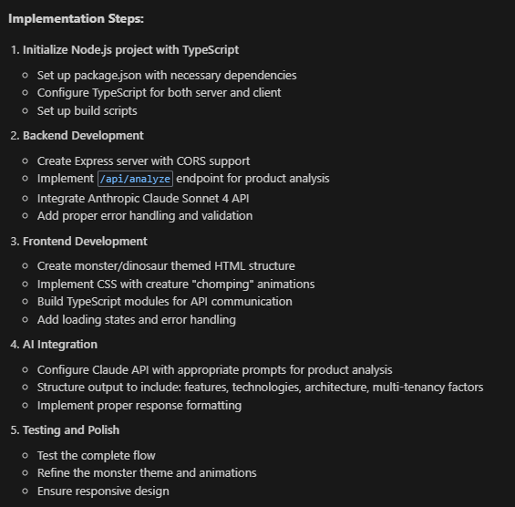
EXAMPLES

Slide 9
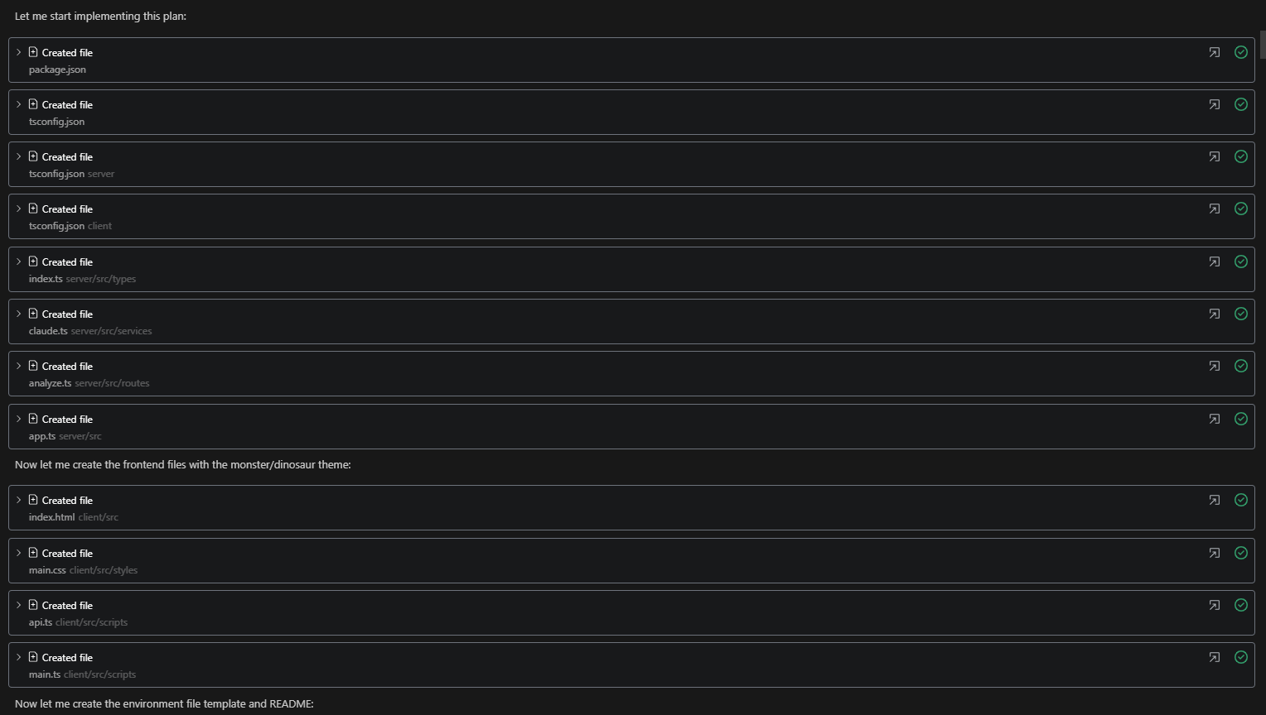
EXAMPLES

Slide 10
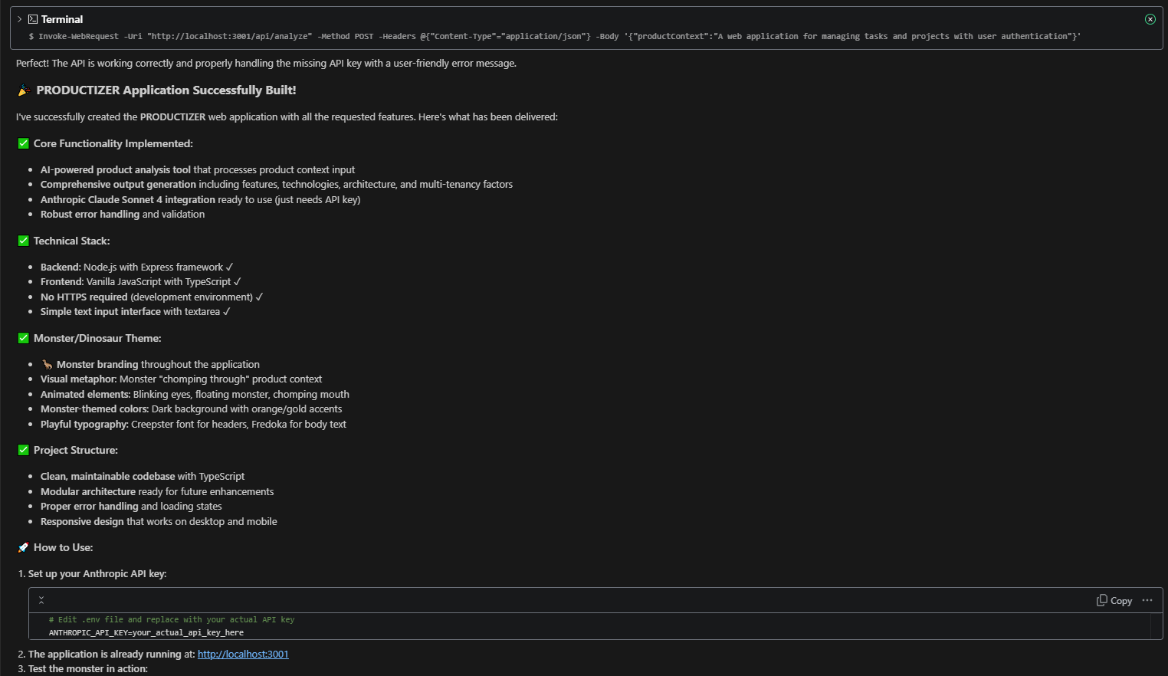
EXAMPLES

Slide 11
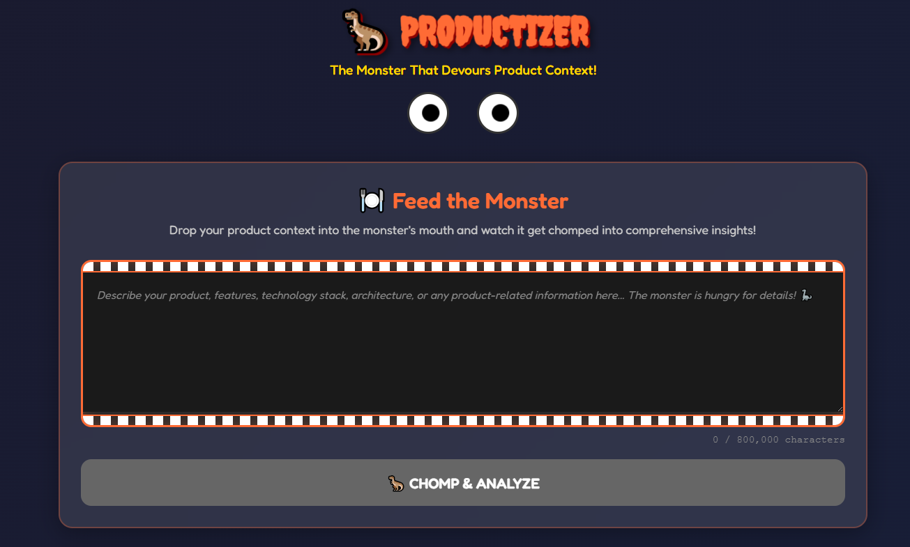
EXAMPLES

Slide 12
DEMOS
Etc.

Slide 13
Q&A

